Slide 1
Hands On: My First Solid Edge Add-In
Greg Chasteen, Technical Account Manager, Siemens PLM Software

Slide 2
Topics Covered
Online Templates for Solid Edge AddIn
What is an Add-In?
Downloading the Template
Updating the AddIn
Register Your Dll
View Your AddIn
Enable/Disable Your AddIn
Debug Your Add-In
This presentation will mainly use Visual Basic delivered with Visual Studio 2012.

Slide 3
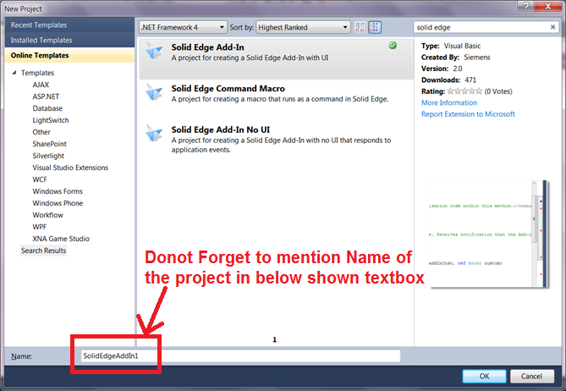
Online Solid Edge Templates for SE Customization
Run file/new project. Click “online templates” and enter “solid edge” in the search box and do the search.

Slide 4
Online Solid Edge Templates for SE Customization
Solid Edge Add-In
A project for creating a VB .NET based Solid Edge Add-In that has has a user interface in Solid Edge. The add-in implements the “ISolidEdgeAddIn” interface and also responds to Solid Edge application events by implementing the “ISEApplicationEvents” interface. The add-in also supports the Solid Edge edgebar user interface. The add-in also has support for the Solid Edge File User Interface event set, the Solid Edge Bar Events and Solid Edge Shortcut Menu events by implementing the appropriate event interfaces
Solid Edge Command Macro
A project for creating a macro that runs as a command in Solid Edge. The project will connect to a running instance of Solid Edge or create an instance of Solid Edge if one is not running. Then if a document is opened, the project creates a command in Solid Edge with mouse locate capability. If an instance of Solid Edge is started, a new part document is automatically created.

Slide 5
Online Solid Edge Templates for SE Customization
Solid Edge Add-In No UI
A project for creating a VB .NET based Solid Edge Add-In that has has a user interface in Solid Edge. The add-in implements the ISolidEdgeAddIn interface and also responds to Solid Edge application events by implementing the ISEApplicationEvents interface. The add-in also supports the Solid Edge edgebar user interface. The add-in also has support for the Solid Edge File User Interface event set, the Solid Edge Bar Events and Solid Edge Shorcut Menu events by implementing the appropriate event interfaces.

Slide 6
Downloading the Template
Solid Edge Add-In
After clicking on Solid Edge Add-In it will download and install add-In template for first time user.
If you have used it before then it will not download but only open the previously downloaded template in Visual Studio 2012 installed on your machine.
After the project is opened in VS2012 right click on the project to add references into the it.
You can add required Solid Edge references in the project.
Now save the project at some convenient location.
Note:- To remove previously installed Add-In template, Go to Tools → Extensions and Updates → Click on Solid Edge Add-In and choose “Uninstall”.

Slide 7
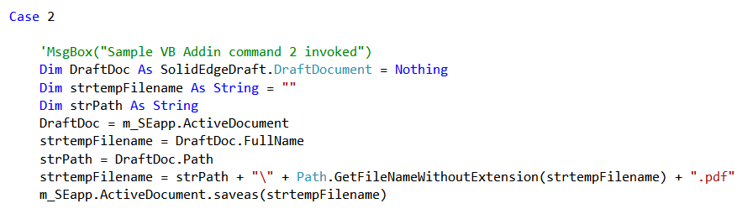
Updating the Add-In
Solid Edge Add-In
Now open Commands.vb and goto “m_addinEvents_OnCommand”.
Add below code in Case 2. This code will save the draft file to .pdf.
Now right click on the project and “Build” the dll.
You have to register this dll to make it appear within Solid Edge. You can register the dll using command prompt OR You can create a bat file at the same location where this dll is created with following code.

Slide 8
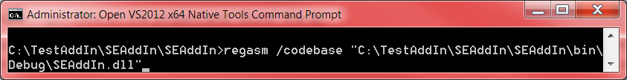
Register your dll
You have to register this dll to make it appear within Solid Edge.
To register this dll go to Start --> All Programs --> Visual Studio 2012 → Visual Studio Tools → VS2012 x64 Native Tools Command Prompt
Type command as “regasm <space> /codebase <space> followed by path of the dll that you have created just now ”
You can register the dll using command prompt OR You can create a bat file at the same location where this dll is created with following code.

Slide 9
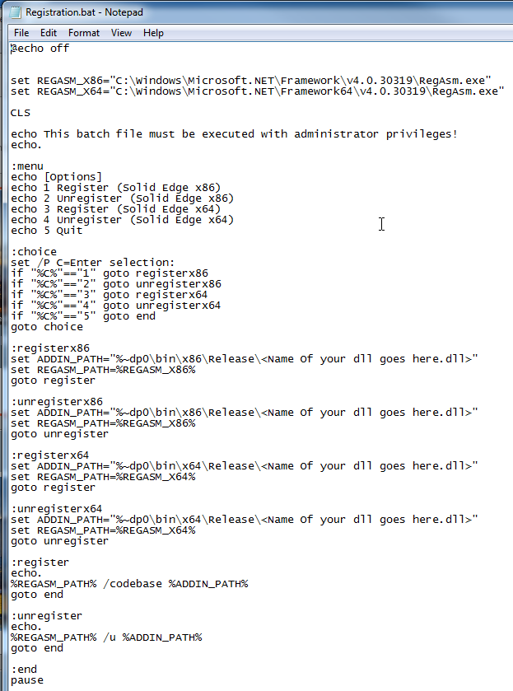
Register your dll
Registration.bat
In folder:
BeginnerTrack\Hands-On My First SE Add-In\Save Your Program Here

Slide 10
Unregister your dll
Unregister this dll to make it disappear from Solid Edge.
To unregister this dll go to Start --> All Programs --> Visual Studio 2012 → Visual Studio Tools → VS2012 x64 Native Tools Command Prompt
Type command as “regasm <space> /unregister <space> followed by path of the dll.

Slide 11
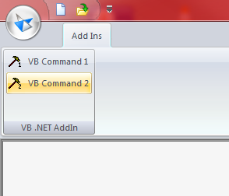
View your Add-In
You can see the add-in as shown below.
Now open any draft file and click on “VB Command 2”. You will see that the pdf file is created at the same location where the draft file is already saved.

Slide 12
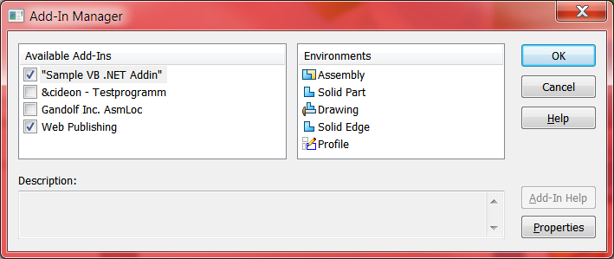
Add-In Not Required
If you don’t need this Add-In then you can goto File Menu → AddIns →as shown below and uncheck the not required Add-In

Slide 13
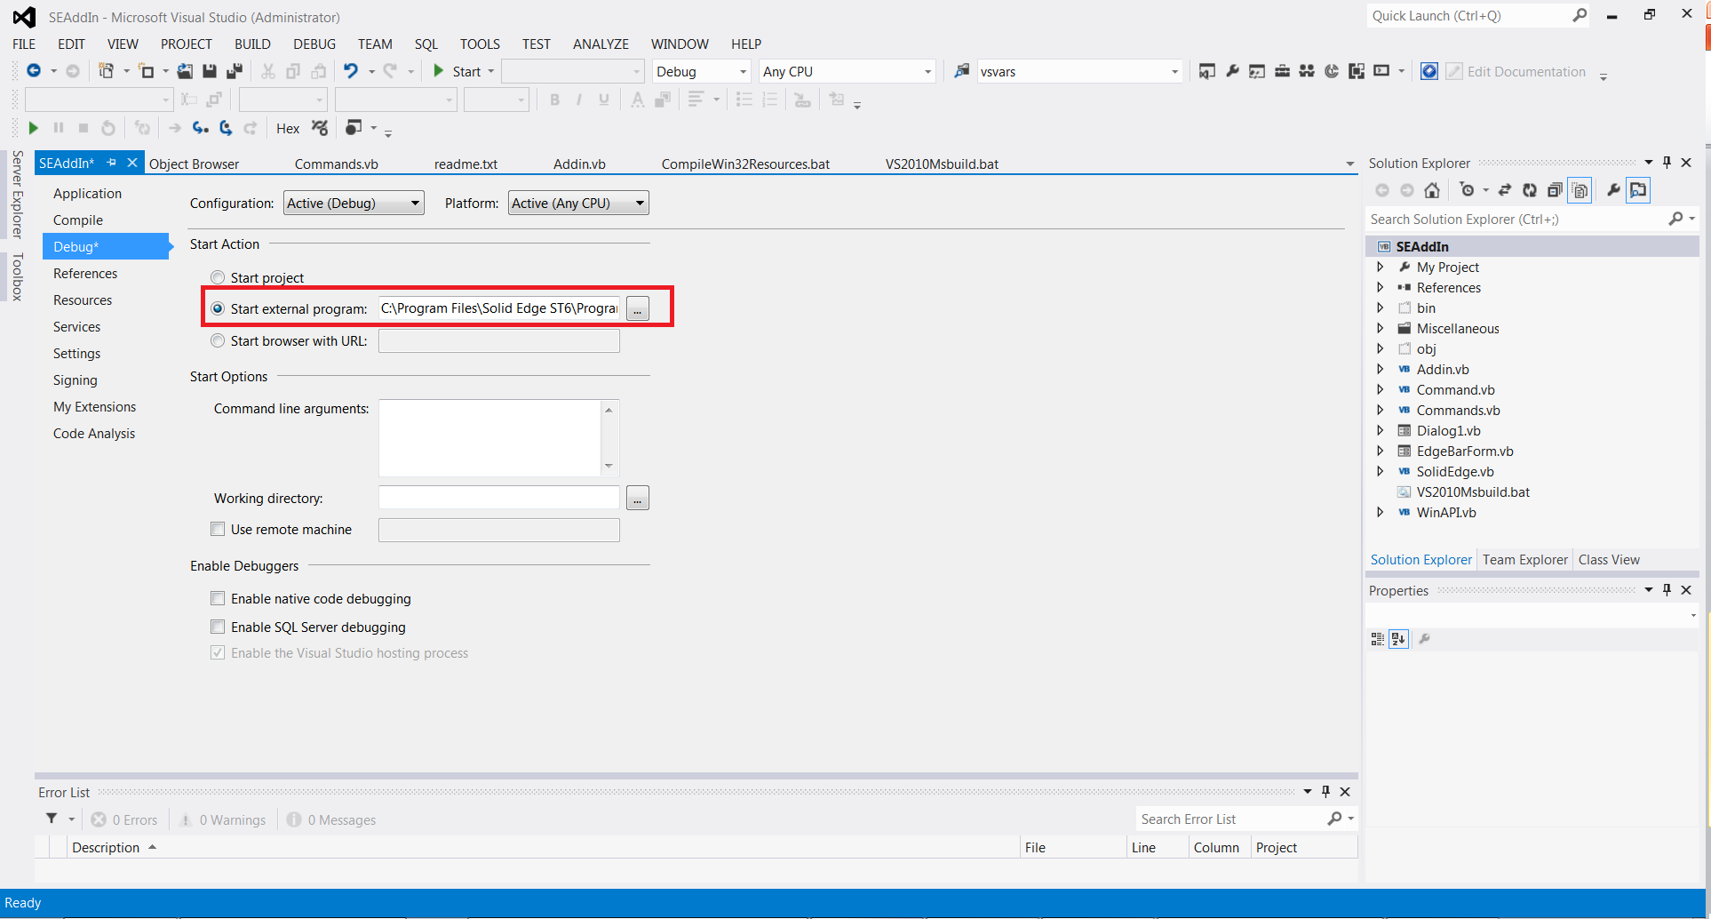
Debug Your Add-In
You can debug this code by specifying path of Solid Edge application in VS2012 project as shown below.
Right click on your project in Project Explorer → Properties → Debug

Slide 14
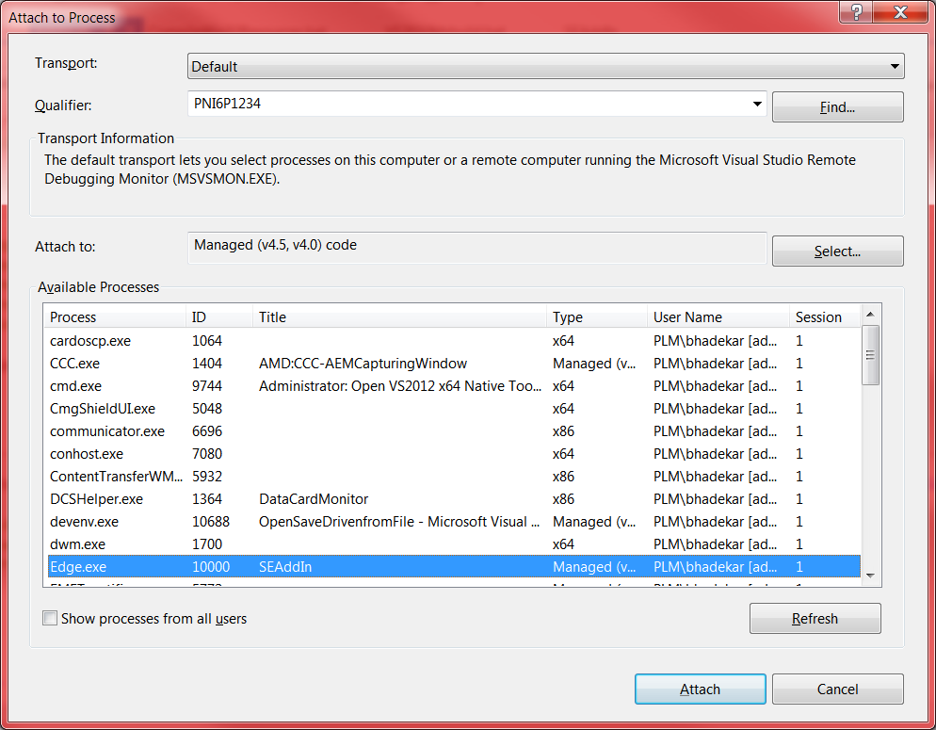
Debug Your Add-In
You can debug this code after attaching this solution to Solid Edge process
Go to Debug → Attach to Process → Click on “Edge.exe” as highlighted below

Slide 15
Lets take a look at another Add-In
BeginnerTrack\_03-Hands-On My First SE Add-In\CheckDimensionRoundingBehavior

Slide 16
Contact
Greg Chasteen
Technical Account Manager
Siemens PLM Software
675 Discovery Drive, Suite 100
Huntsville, Al 35806
Office: (256) 705-2621
Cell:(256) 479-9055
E-mail:
chasteen.gregory@siemens.com

